Slide 1
Sequencing

Slide 2
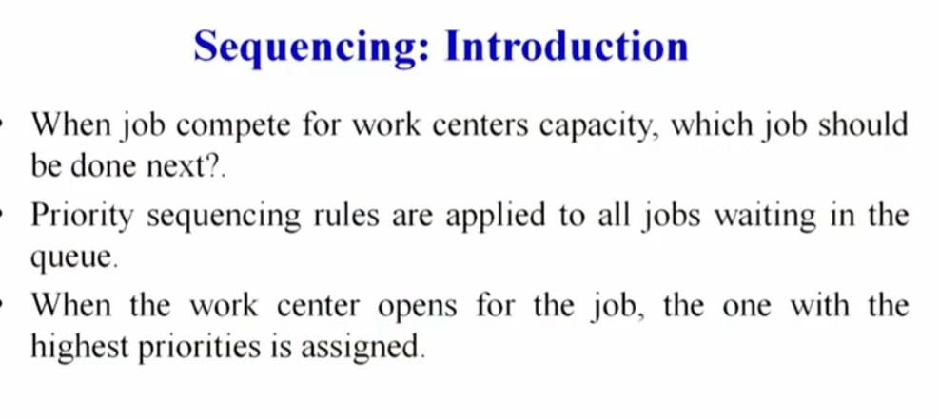

Slide 3
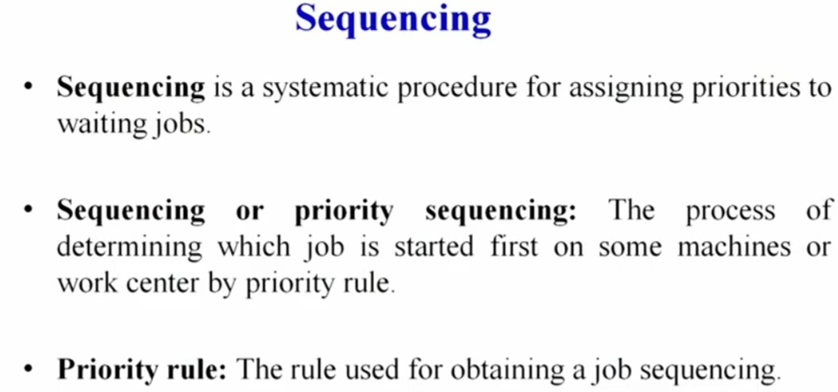

Slide 4
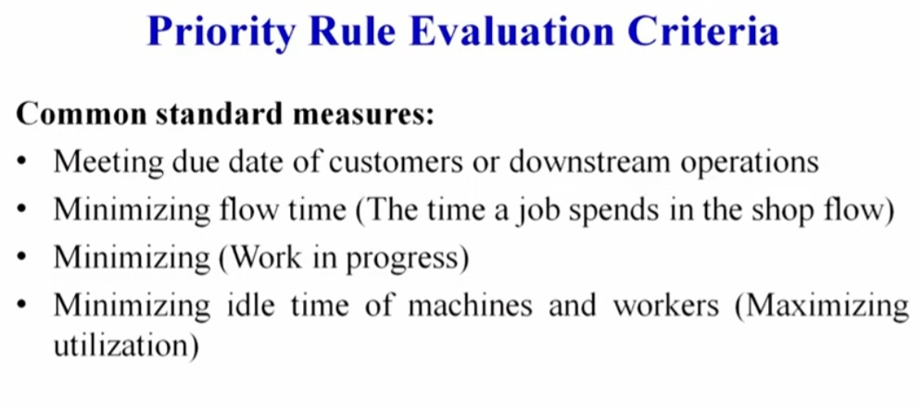

Slide 5
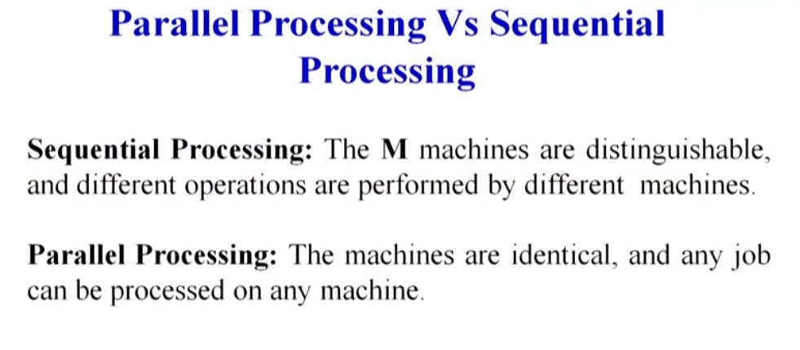

Slide 6
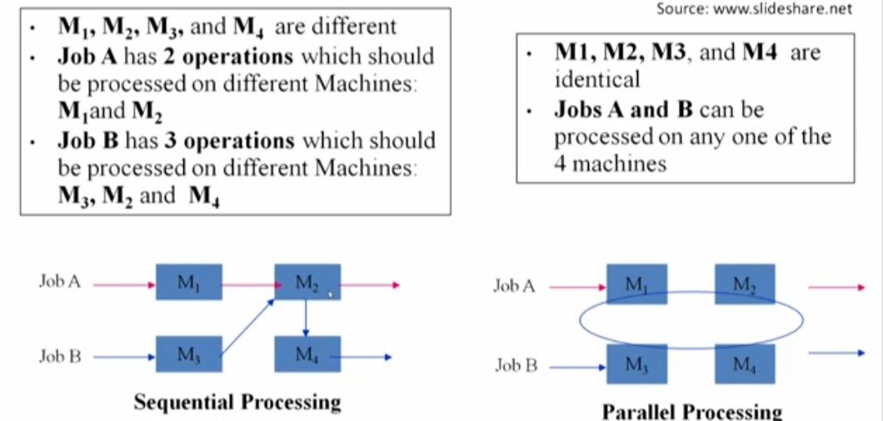

Slide 7
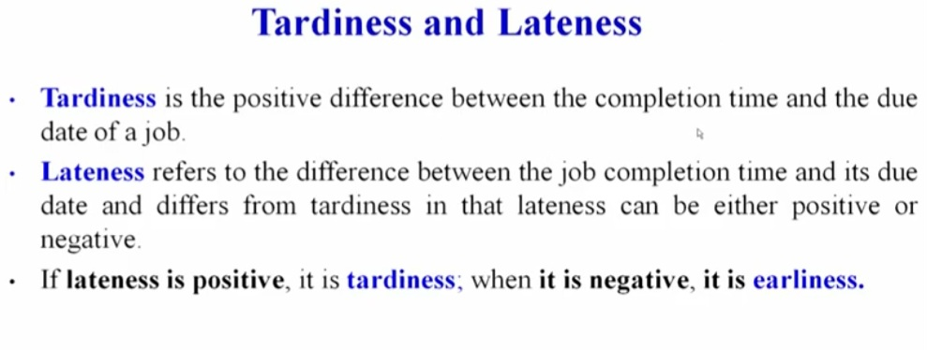

Slide 8
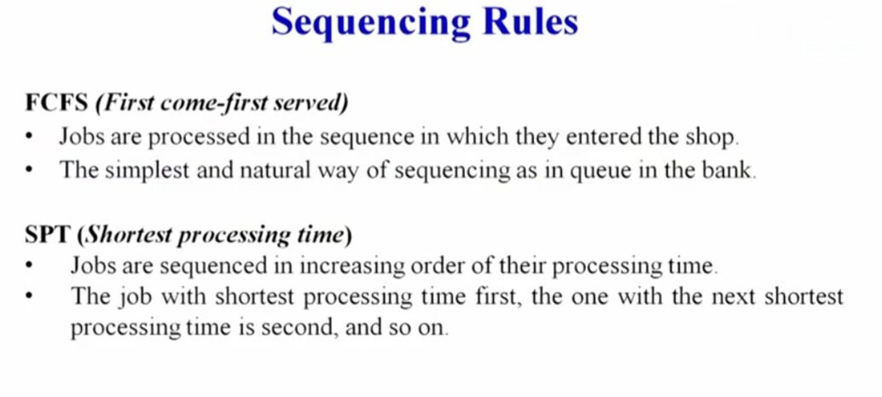

Slide 9
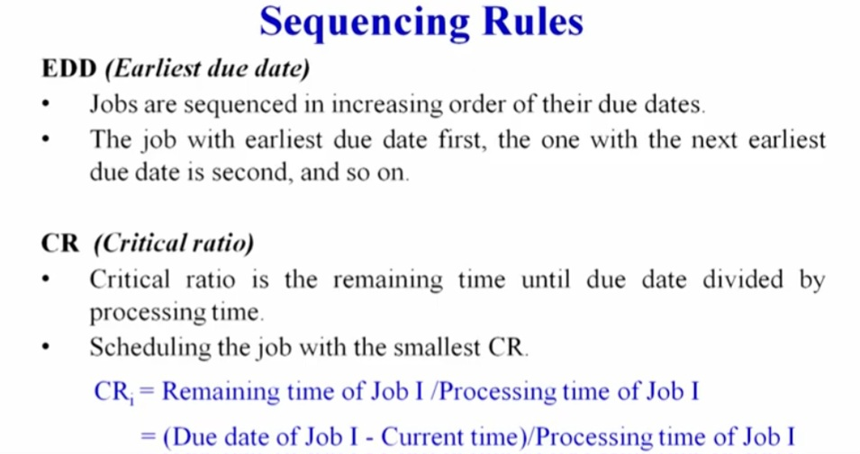

Slide 10
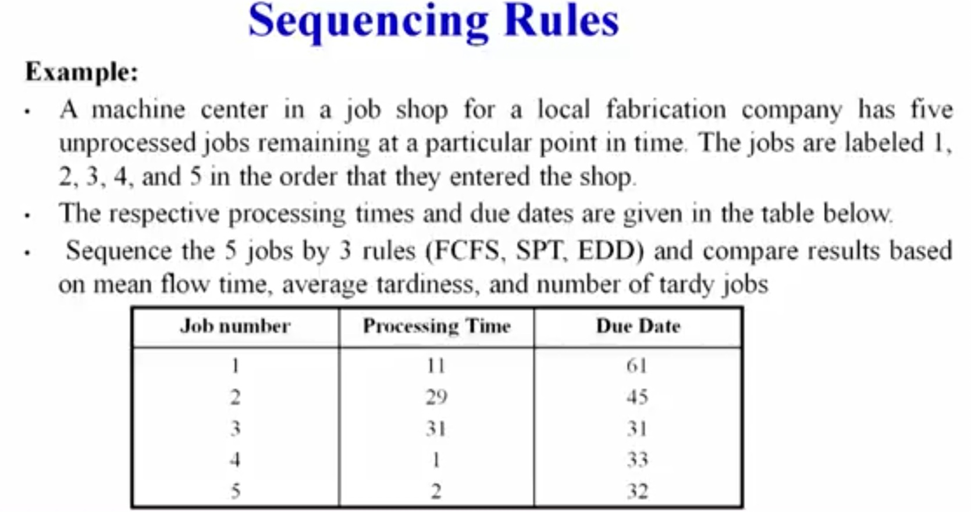

Slide 11
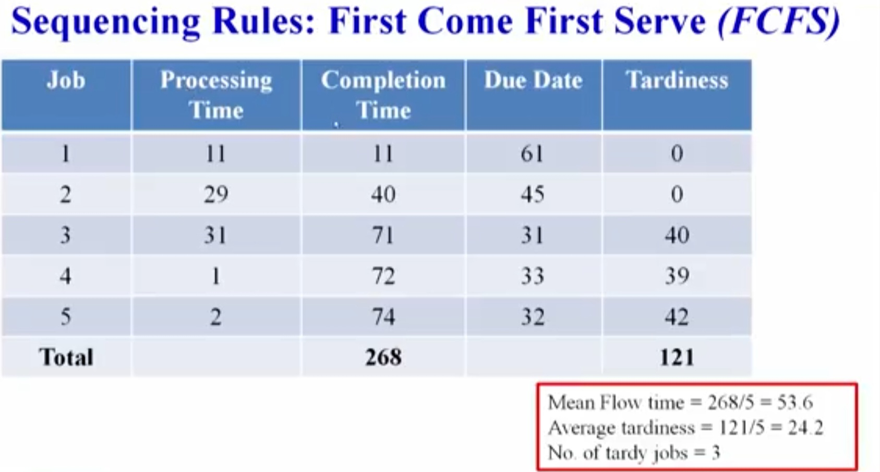

Slide 12
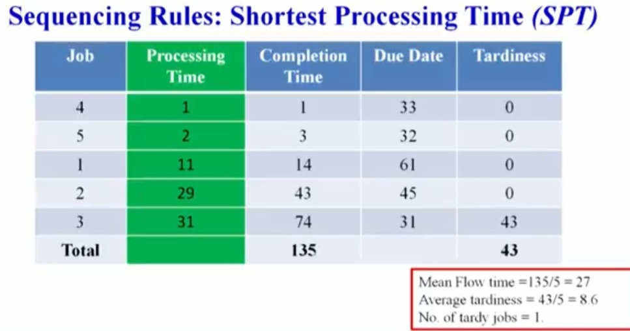

Slide 13
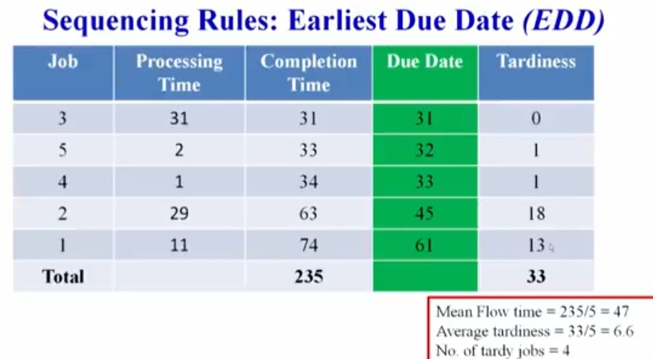

Slide 14
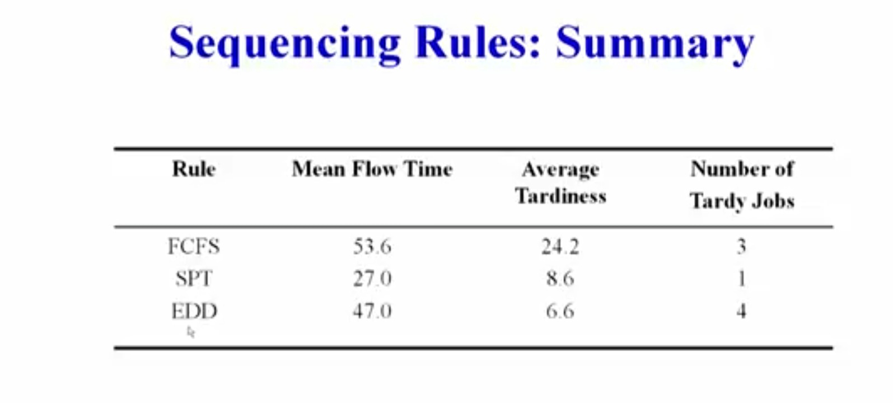

Slide 15
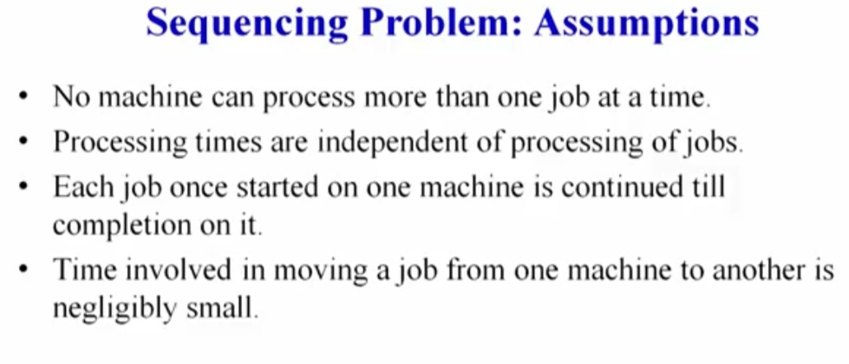
.

Slide 16
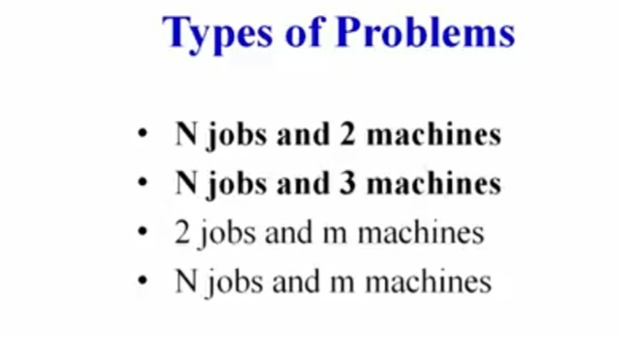

Slide 17
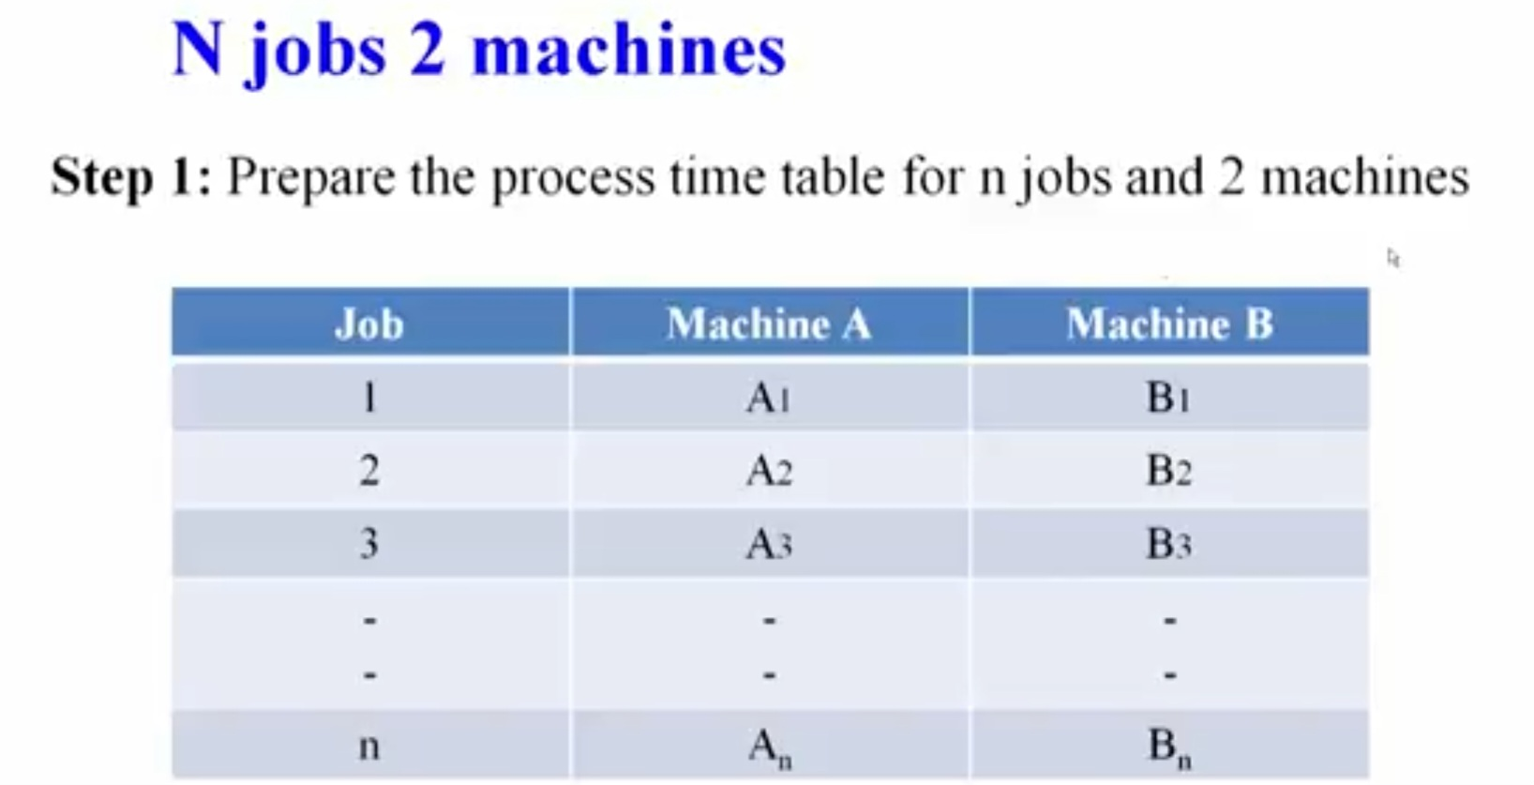

Slide 18
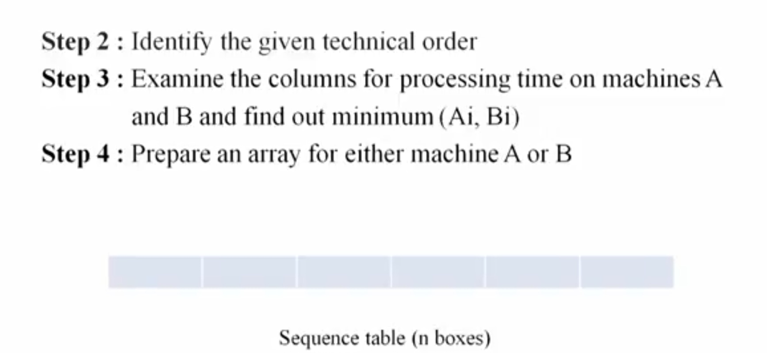

Slide 19
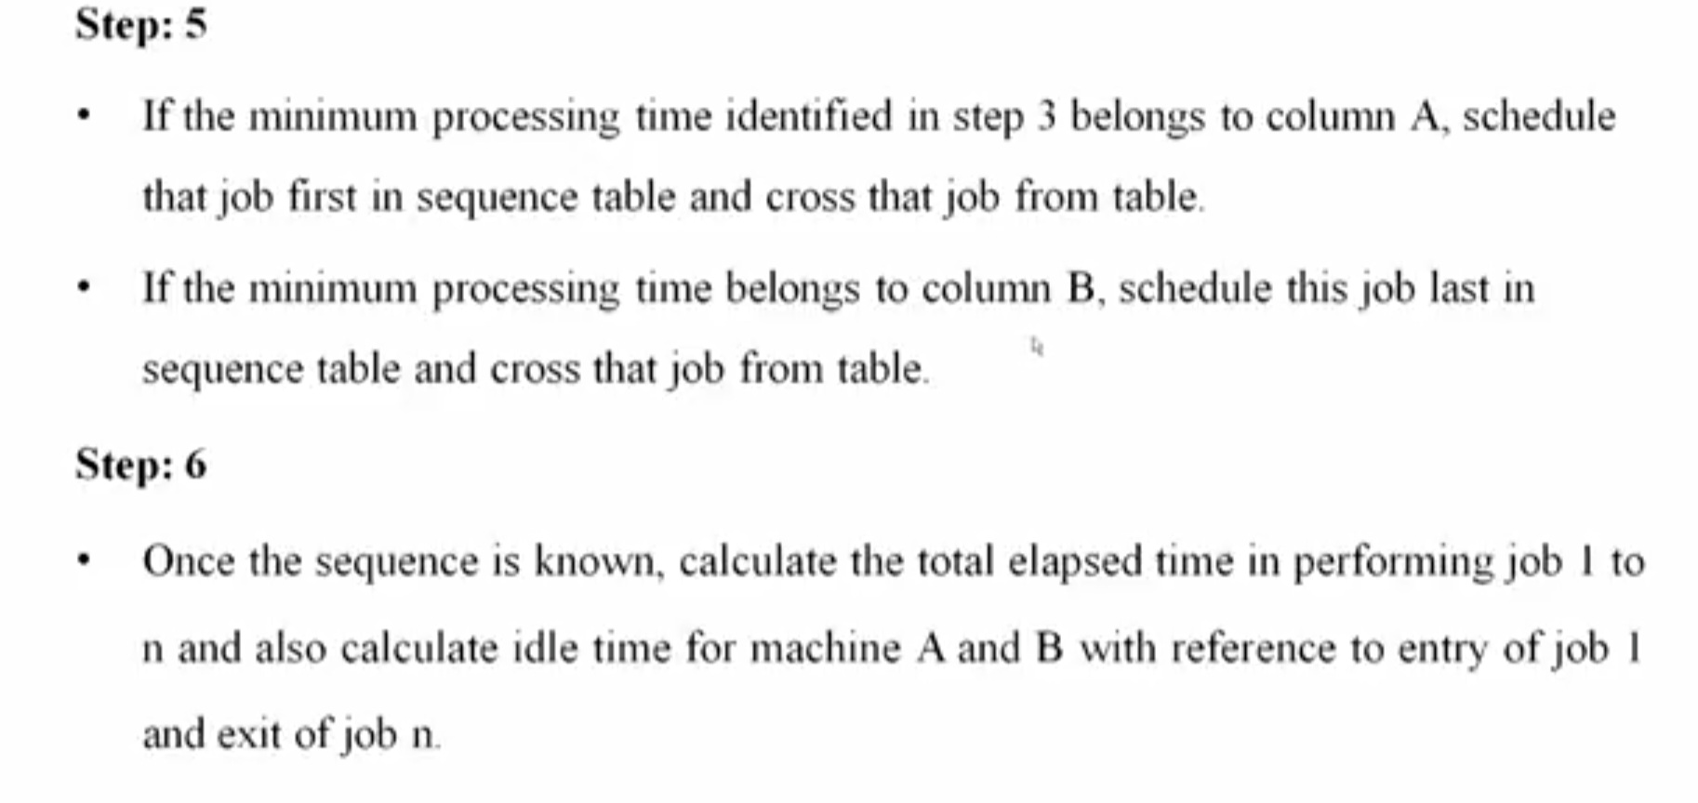

Slide 20
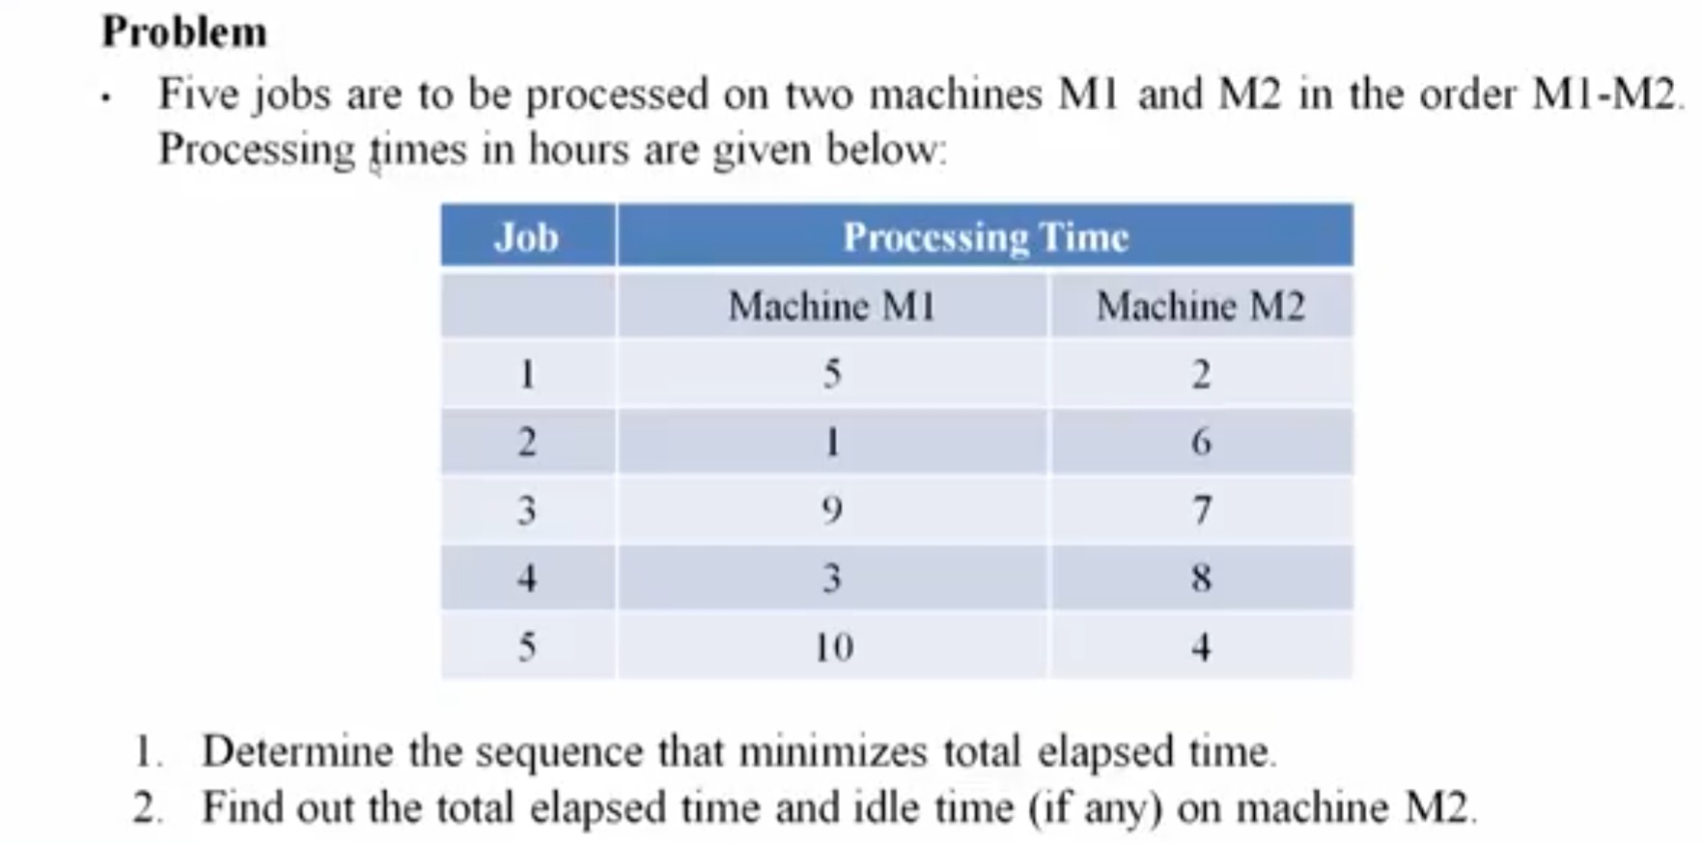

Slide 21
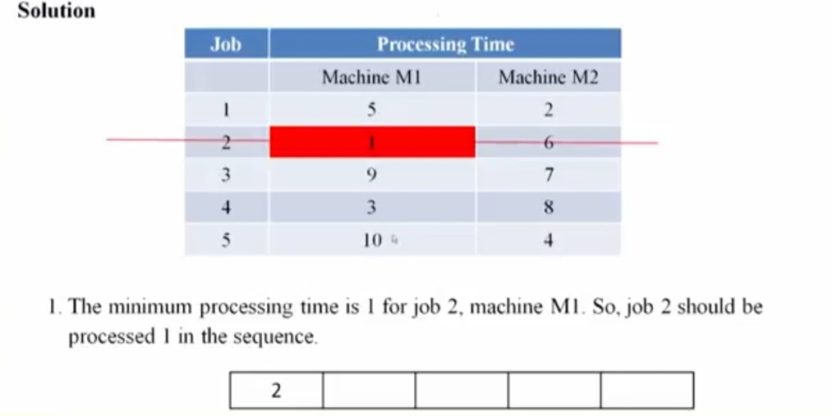
.

Slide 22
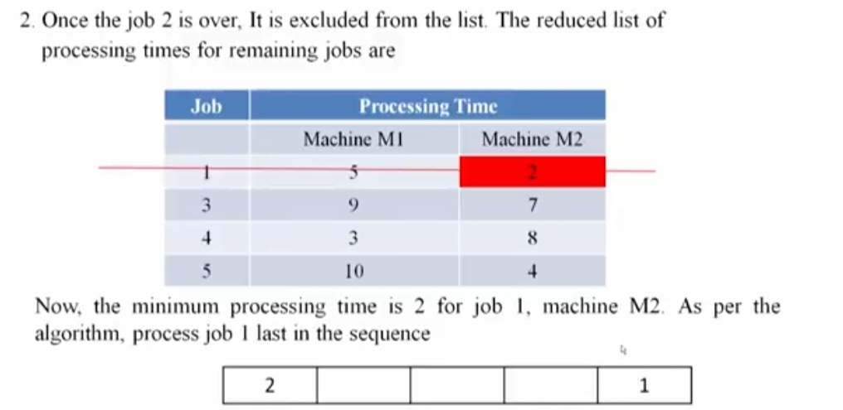

Slide 23
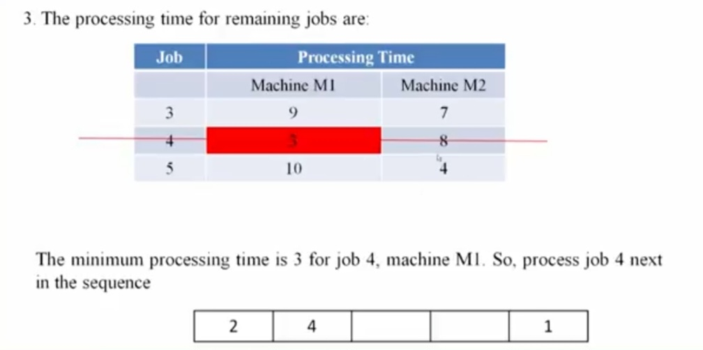

Slide 24
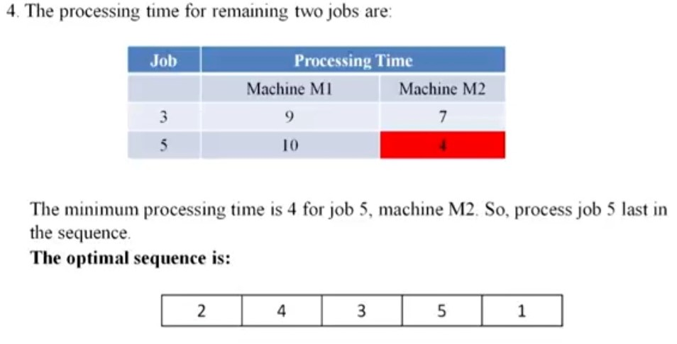

Slide 25
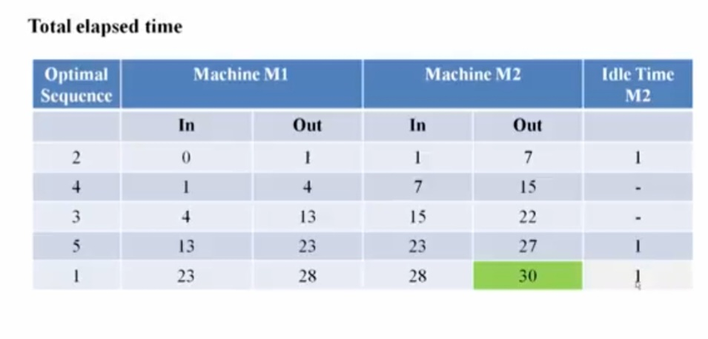

Slide 26
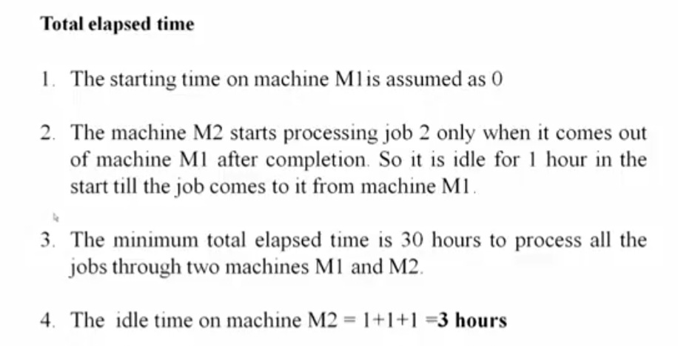

Slide 27
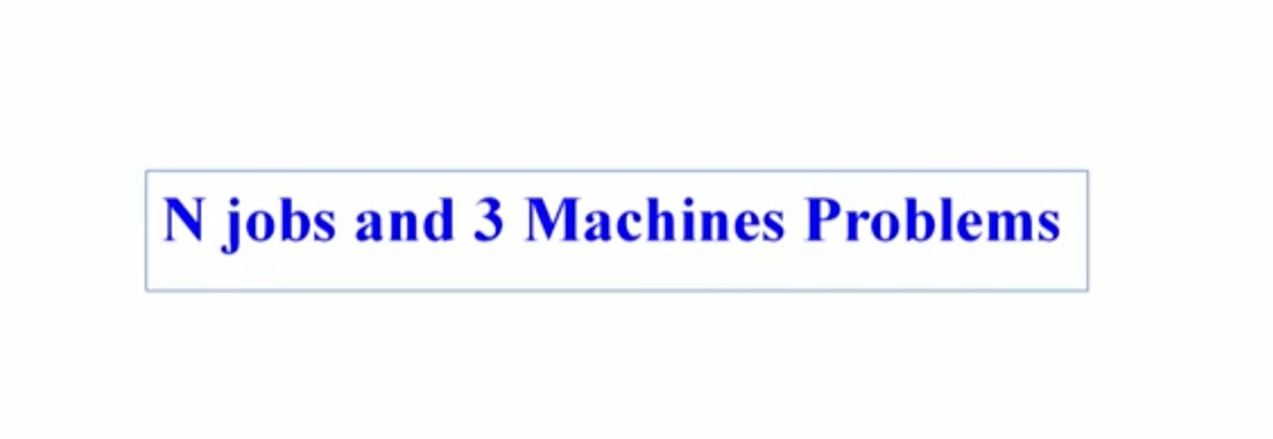

Slide 28
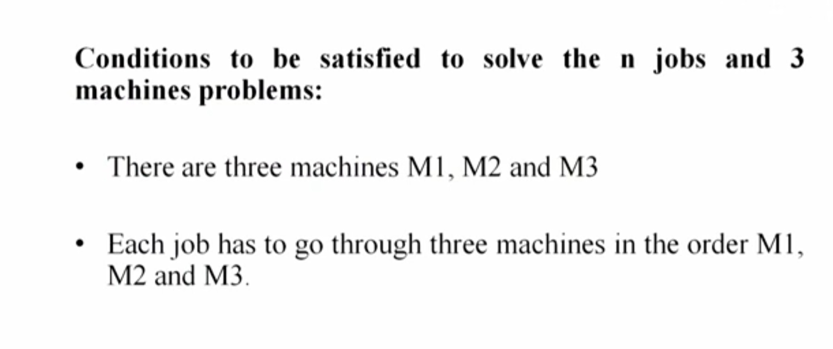

Slide 29
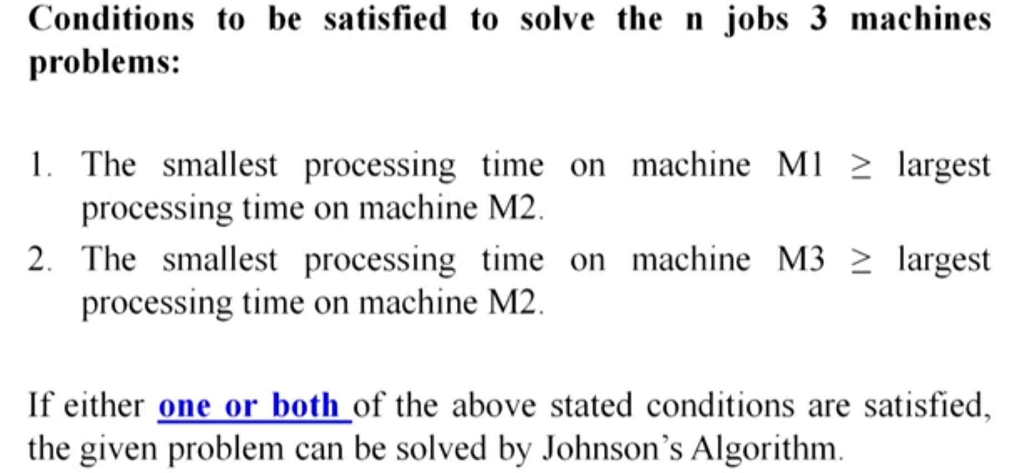

Slide 30
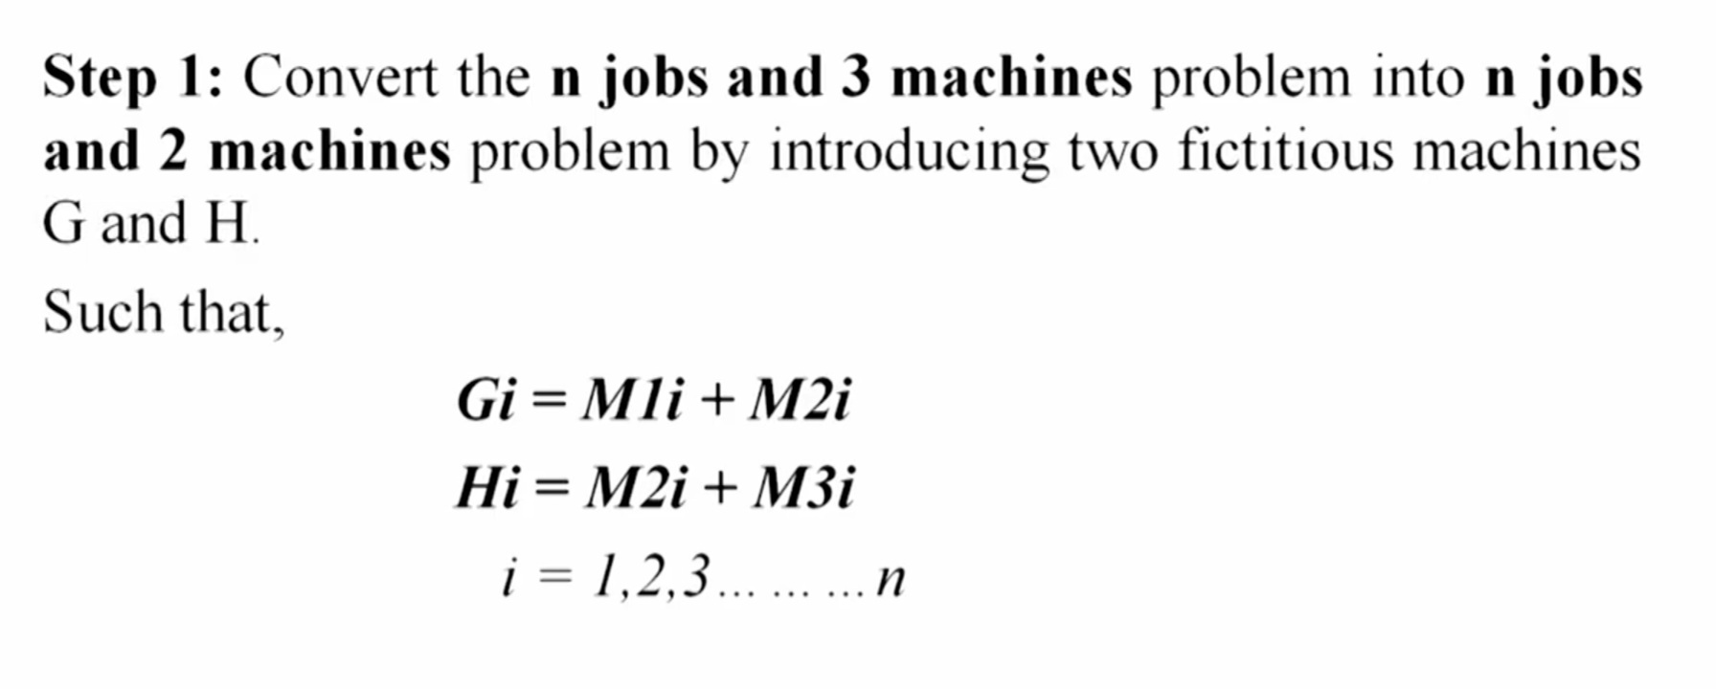

Slide 31
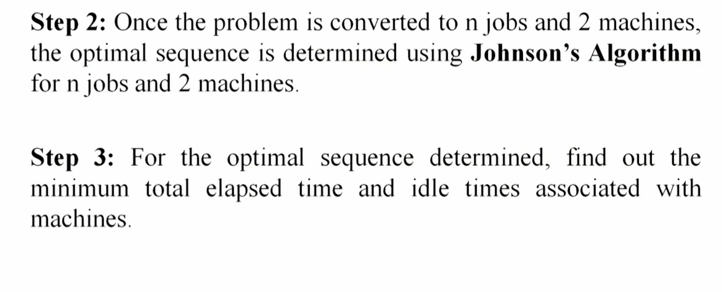

Slide 32
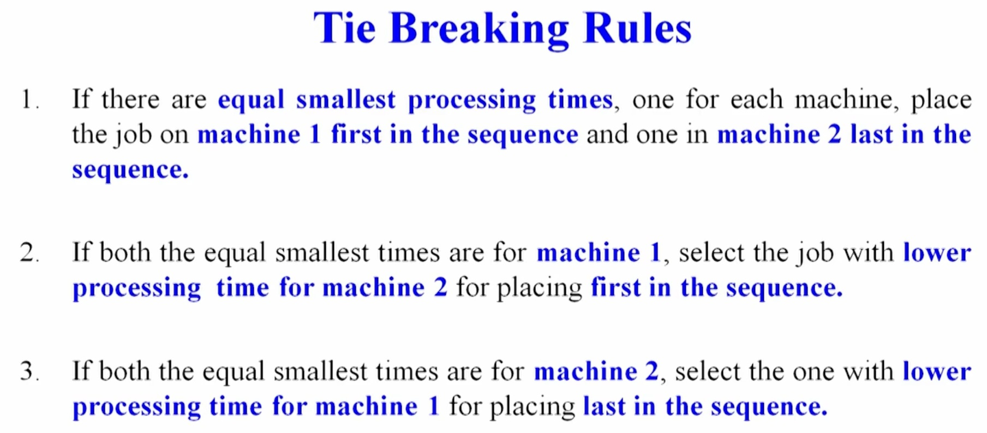

Slide 33
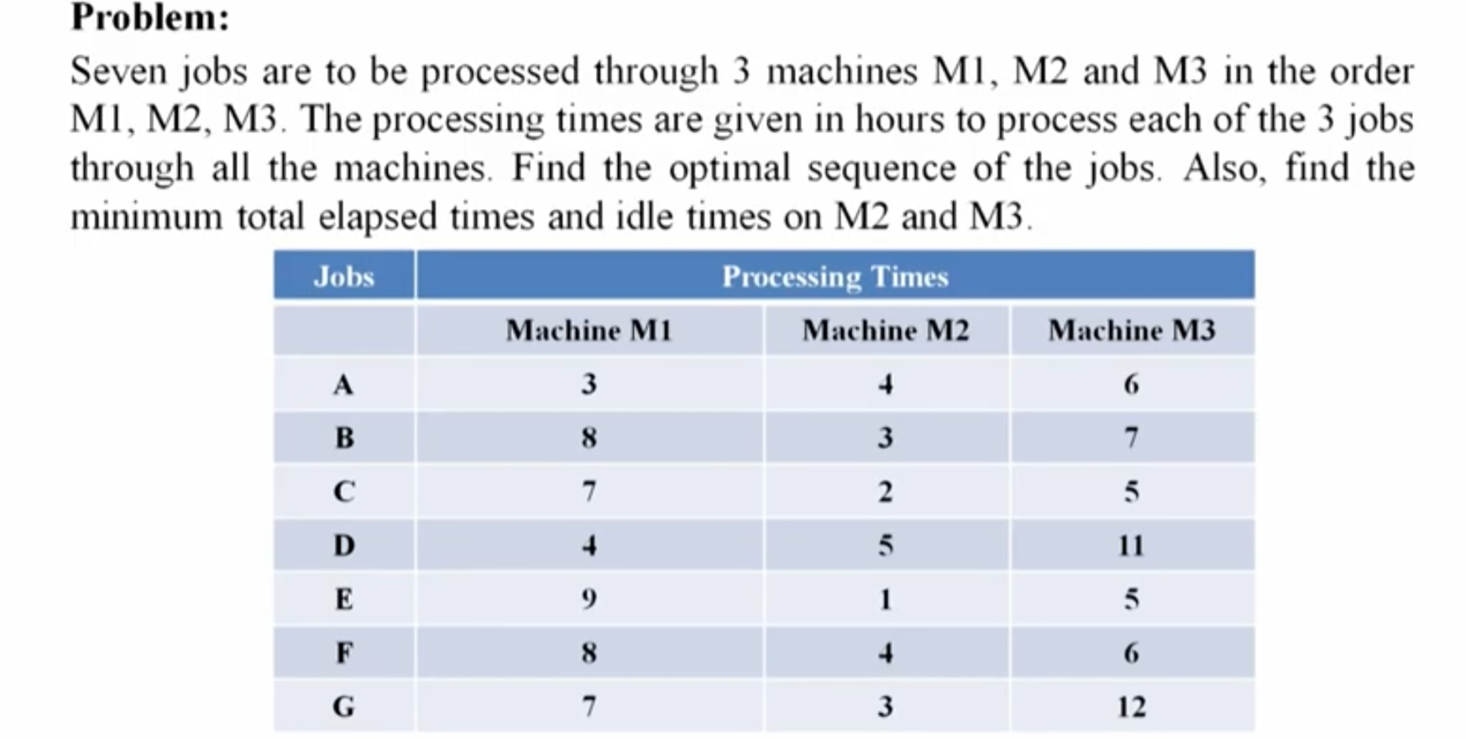

Slide 34
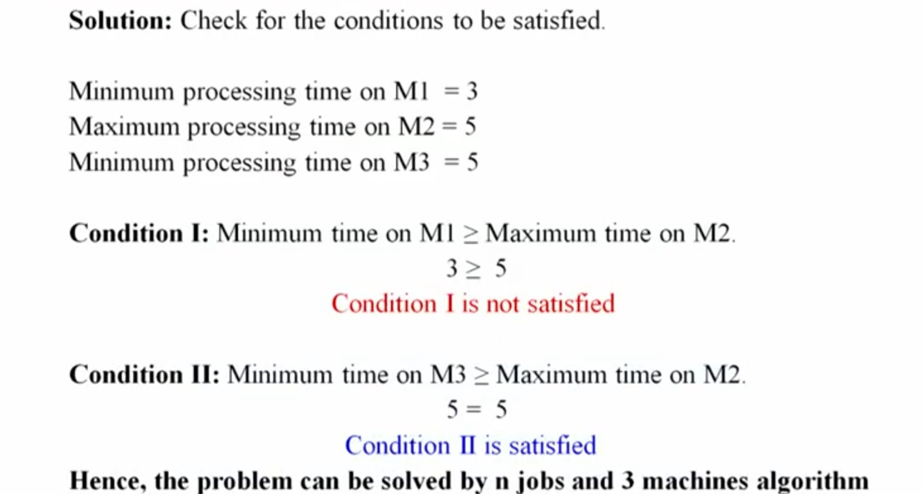

Slide 35
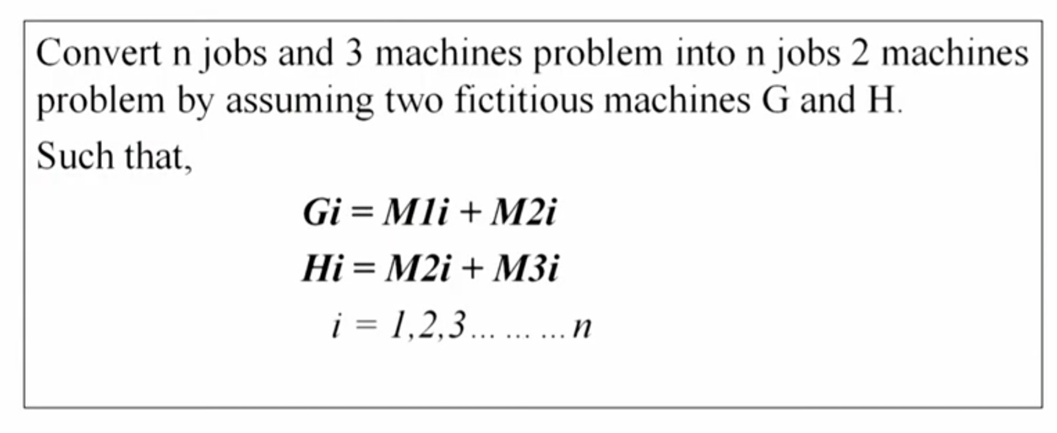

Slide 36
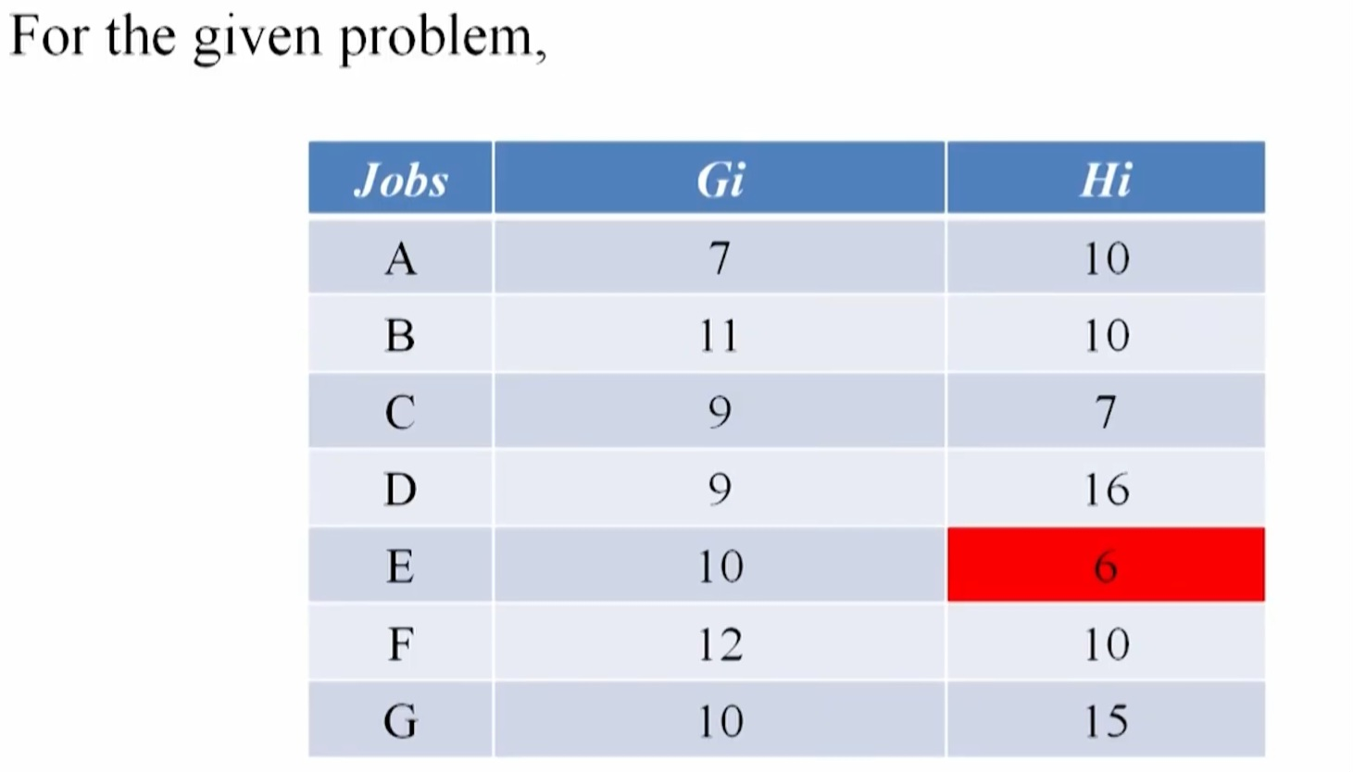

Slide 37
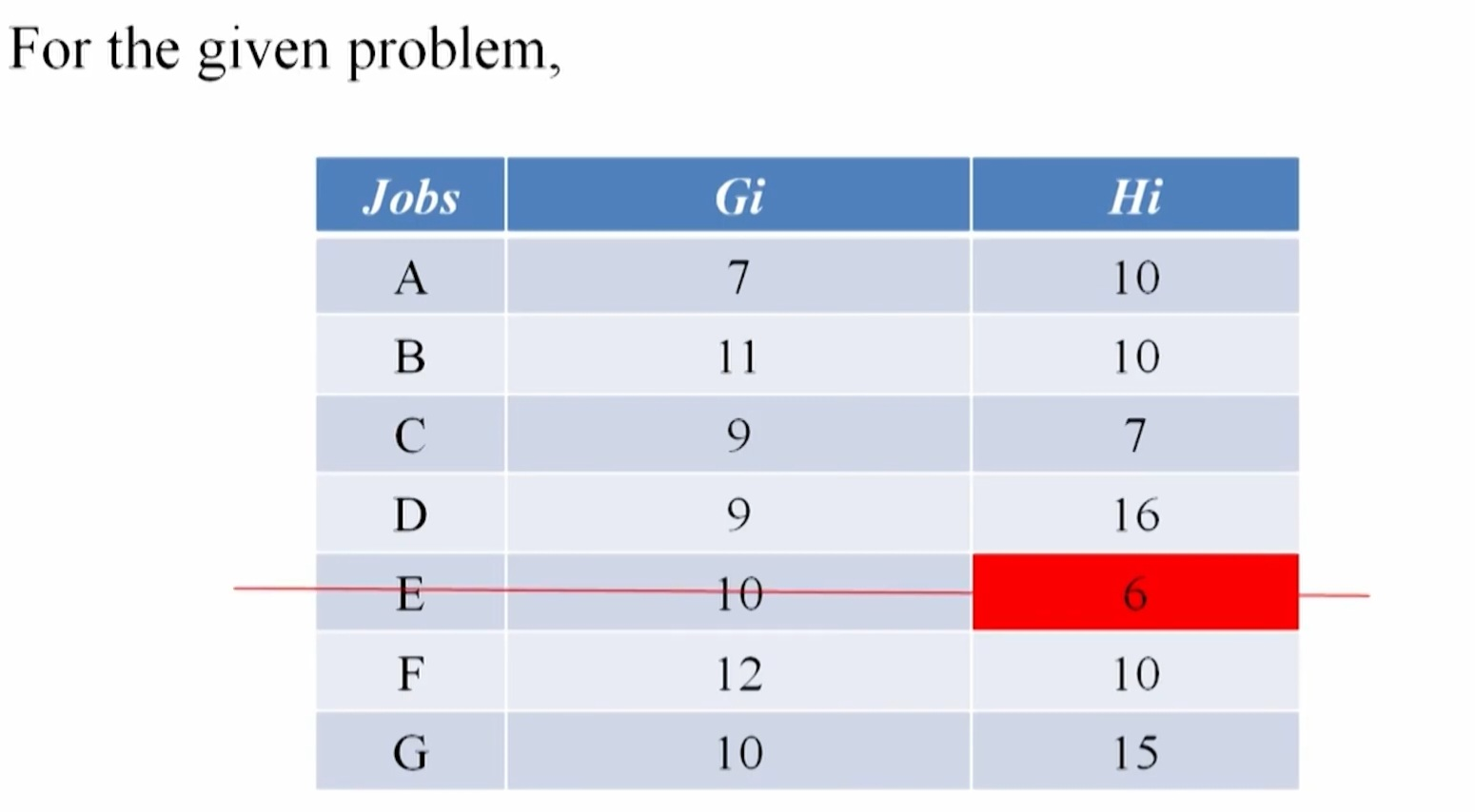

Slide 38
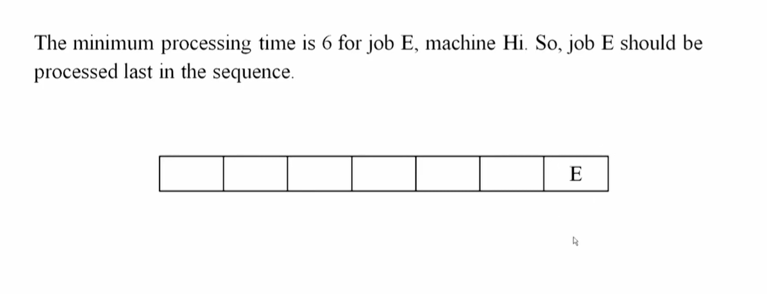

Slide 39
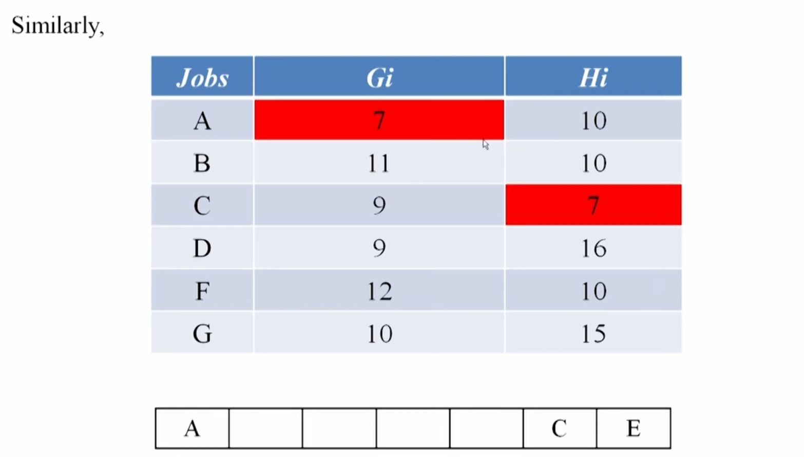

Slide 40
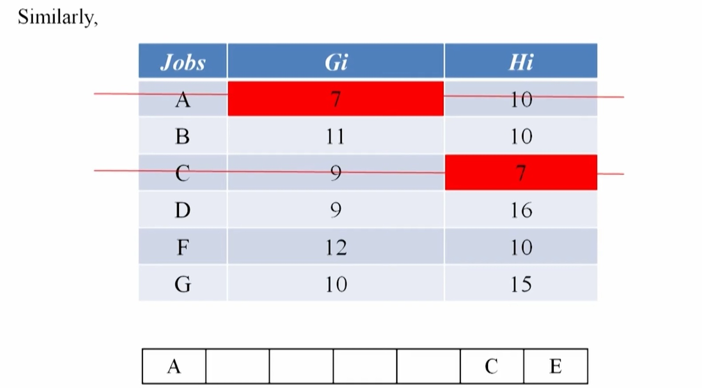

Slide 41
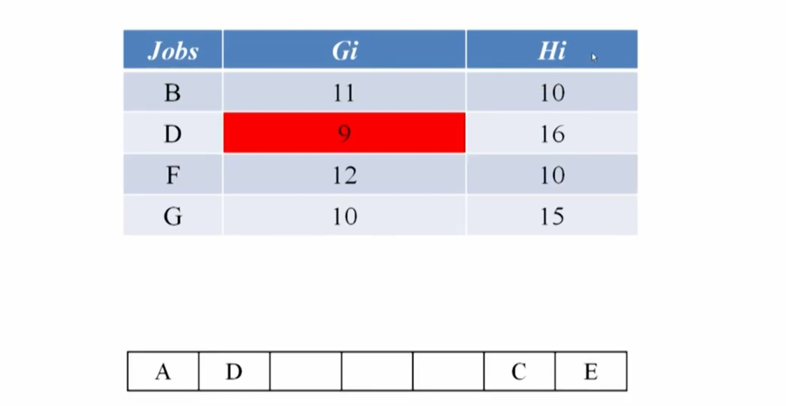

Slide 42
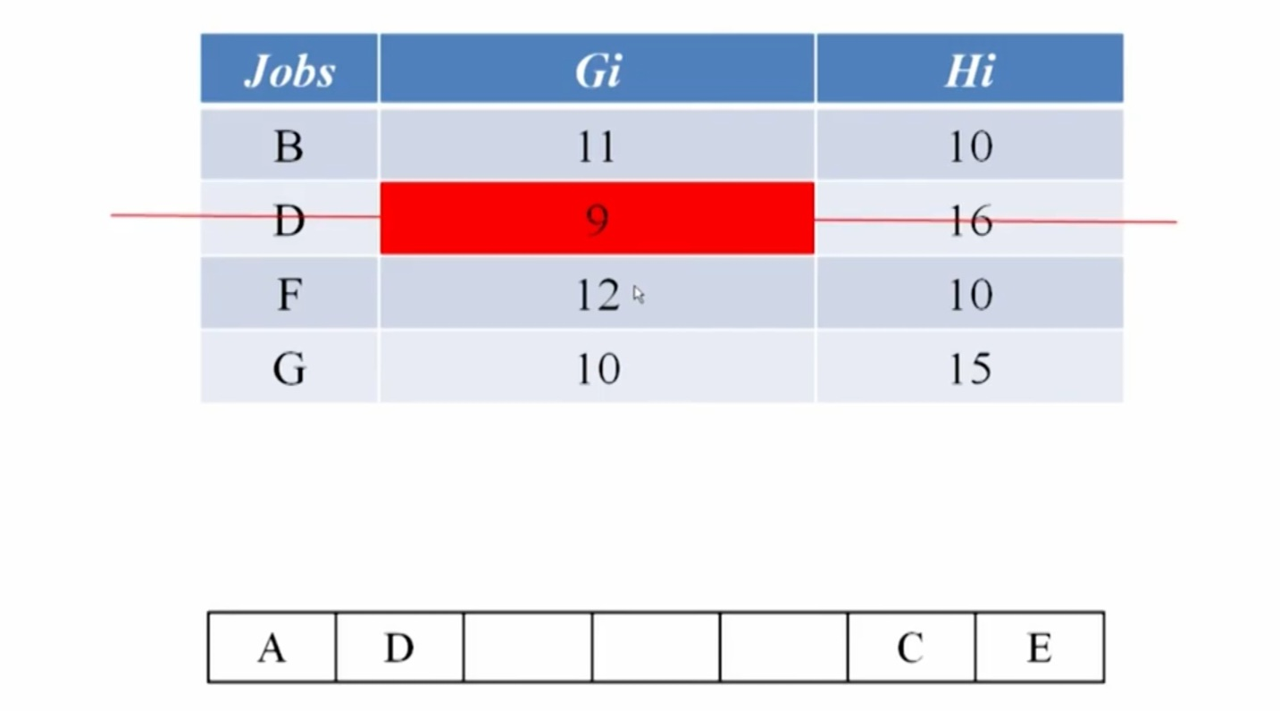

Slide 43
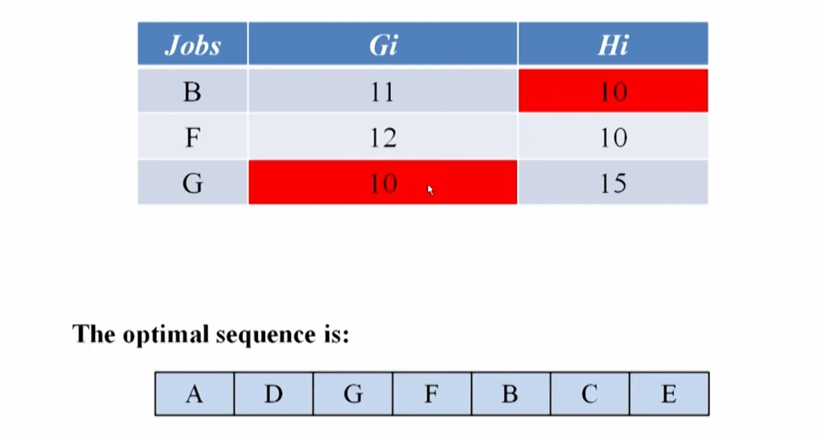

Slide 44
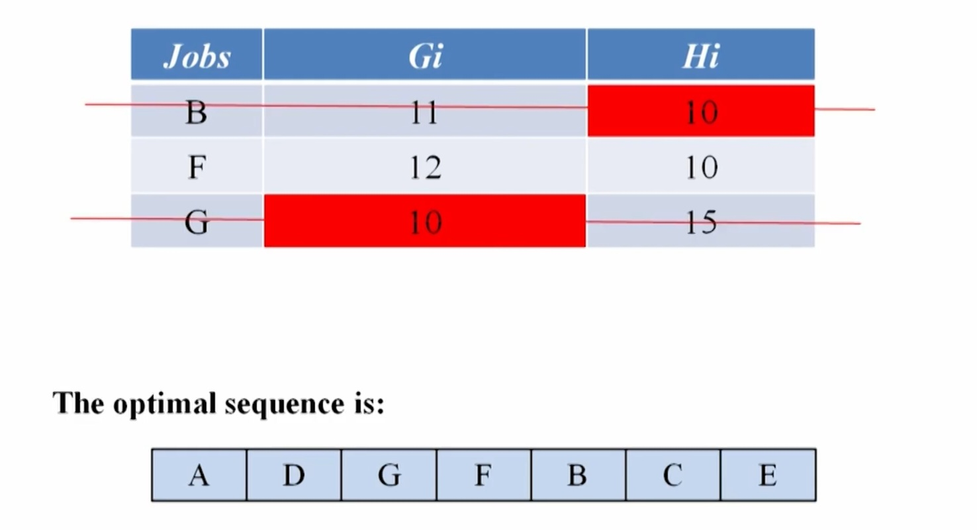

Slide 45
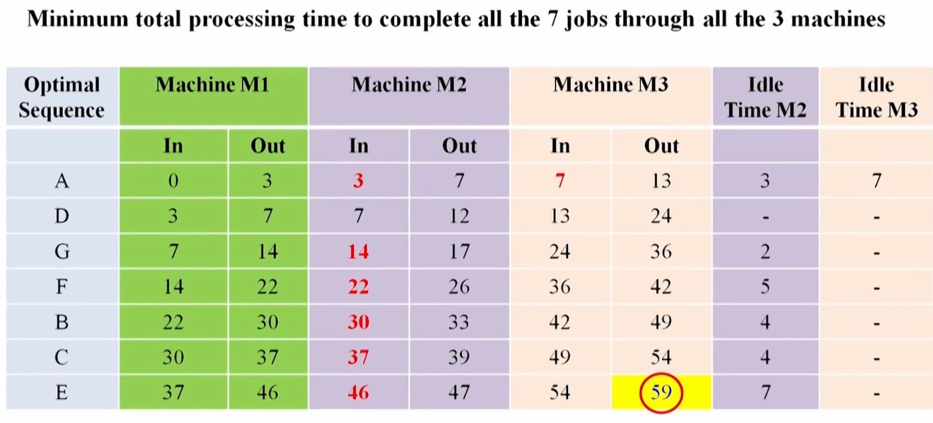

Slide 46
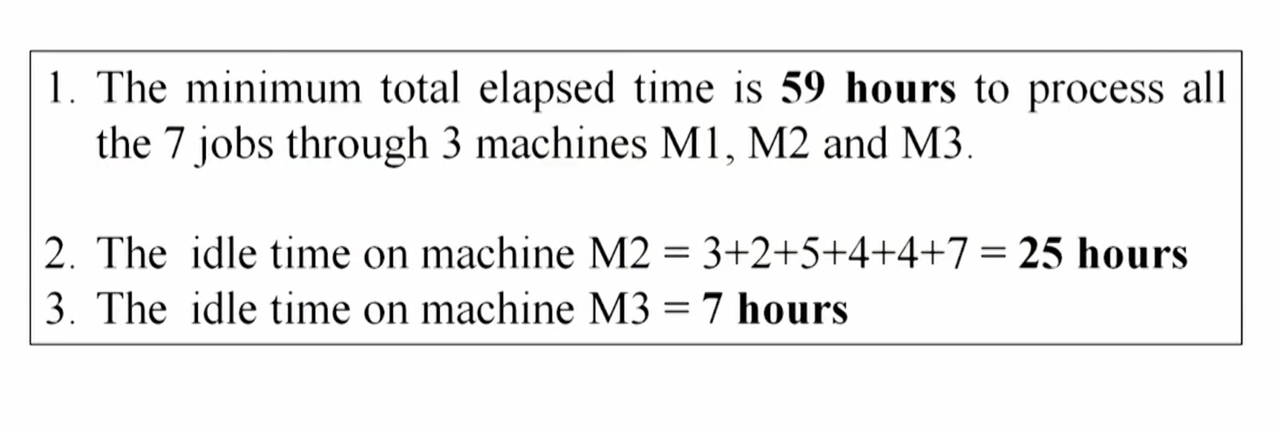

Slide 47
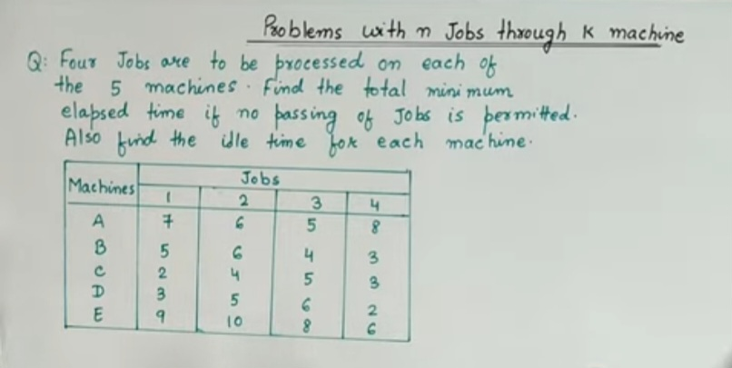

Slide 48
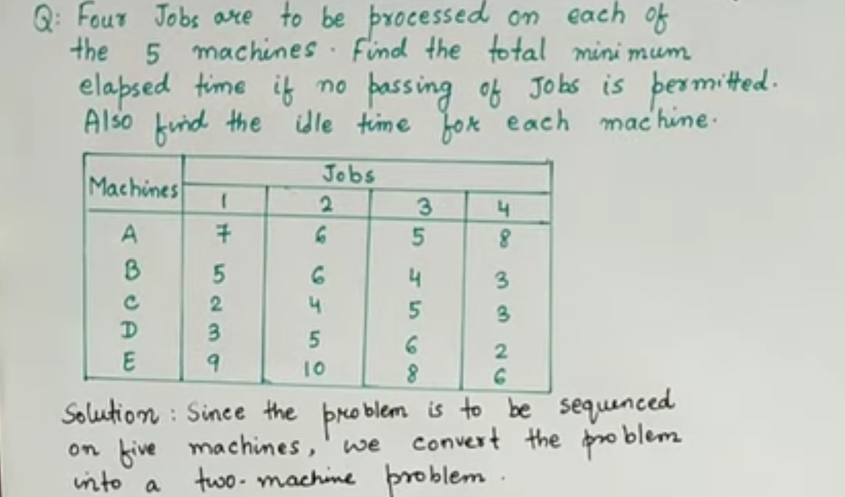

Slide 49
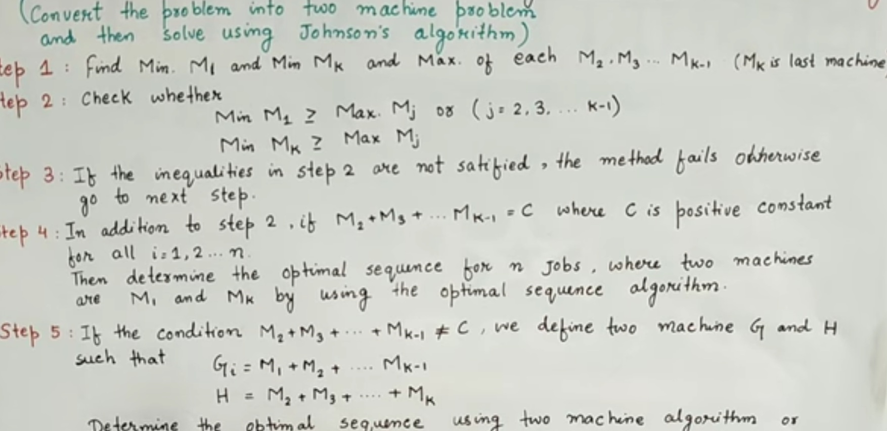

Slide 50
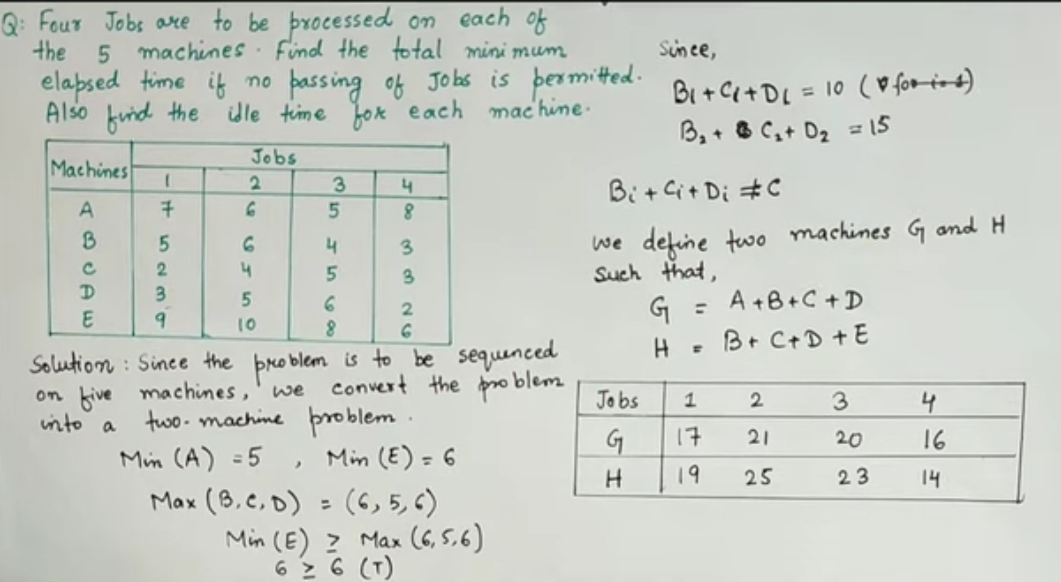

Slide 51
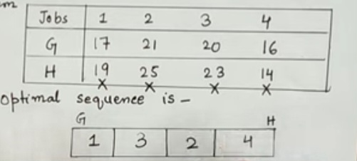

Slide 52


Slide 53


Slide 54


Slide 55


Slide 56


Slide 57


Slide 58


Slide 59


Slide 60


Slide 61


Slide 62


Slide 63


Slide 64
The optimal schedule on various machines for job 1 and job 2
Machine A : J1-J2
Machine B: J2-J1
Machine C: J2-J1
Machine D: J2-J1
Machine E : J2-J1

Slide 65
Sources
nptel.ac.in
Start practicing
www.slideshare.com
www.slideserve.come

Slide 66
Questions For Continuous evaluation
Example 1: There are 5 jobs, each of which has to go through the machines A and B in the order AB. The processing times (in hours) are given as
Job : J1 J2 J3 J4 J5
Machine A : 2 4 5 7 1
Machine B : 3 6 1 4 8
Determine a sequence of these jobs that will minimize the total elapsed time T. Also obtain: i) the minimum elapsed time; and ii) the idle time for each of the machines.
Example 2: Use the graphical method to minimize the time required to process the following jobs on the machines, that is, for each machine specify the job that should be done first. Also calculate the total elapsed time for completing both jobs.
Job 1 Sequence : A B C D E
Time (in hrs) : 6 8 4 12 3
Job 2 Sequence : B C A D E
Time (in hrs) : 10 8 6 4 12

Slide 67
Example 3-Find the sequence that minimizes the total time required in performing the following jobs on three machines in order ABC. Processing times (in hours) are given in the following table :
Job : 1 2 3 4 5
Machine A : 8 10 6 7 11
Machine B : 5 6 2 3 4
Machine C : 4 9 8 6 5
Example 4- Find solution of Processing 5 Jobs Through 4 Machines Problem
Job | 1 | 2 | 3 | 4 | 5
Machine-1 | 11 | 13 | 9 | 16 | 17
Machine-2 | 4 | 3 | 5 | 2 | 6
Machine-3 | 6 | 7 | 5 | 8 | 4
Machine-4 | 15 | 8 | 13 | 9 | 11

Slide 68
Thank You

